Slide 1
Tutorial for ATLA
Database for Theology and Philosophy

Slide 2
Ways to Use the Database
Search for articles in general
Search for articles on specific Scripture texts
Limit searches by
Publication type, genre, peer reviewed, date
Peer reviewed
Full text articles only
Language
Date

Slide 3
Go to the PRS Library Webpage
http://prs.intersearch.com.au/cgi-bin/koha/opac-main.pl

Slide 4
Log Into your PRS Library Account
A user name and password can be obtained from the librarians.
Notes:
Log into library account

Slide 5
Click on the ATLA religion database link
Notes:
Click on ATLA religion database link

Slide 6
Click on the Online Access link
Notes:
Click on the Online Access link

Slide 7
Click on the AtlaSerials PLUS,
Religion Collection link
Notes:
Click on AtlaSerials Plus, Religion collection link

Slide 8
Type in as much information as helpful
1. Search for Articles in General
You can choose the type of field
Notes:
Laudati Si’ + ecology = 109 hits

Slide 9
Peer reviewed, date, publication type, periodical, genre
3. Limit searches
Notes:
Limit to Scholarly/Peer Reviewed = 56
Limit to Book Reviews = 1

Slide 10
Full Text and Open Access
Preferable since we do not have the ability to do interlibrary loan
Notes:
Limit to Full Text = 81

Slide 11
Limit the languages in your search
Notes:
English only = 42

Slide 12
Limit the date range

Slide 13
Include your search terms within the text of articles
The term may not be in the title but elsewhere
Notes:
Within text = 331
This can also be done by clicking on “Show More” under date while searching.

Slide 14
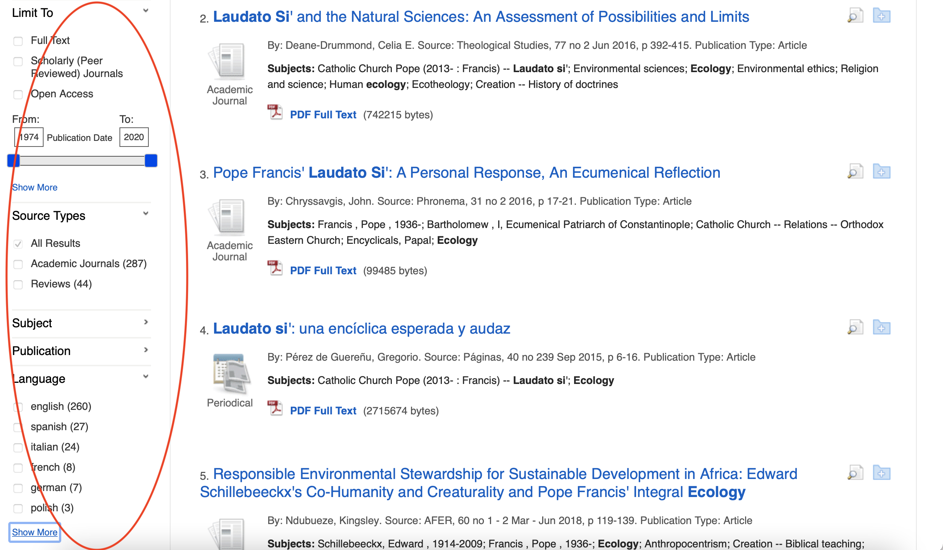
You can also change your choices later
Notes:
All choices can also be made after starting the search

Slide 15
See topics covered in your search,
Which periodicals and which languages the articles are in.

Slide 16
Full Text Articles
Notice: in the left sidebar it is possible to add limitations to the search not yet applied
Notes:
Check to see if the full text article is available.

Slide 17
Put items you like in a folder
Notes:
Click on the folder next to the text you wish to save

Slide 18
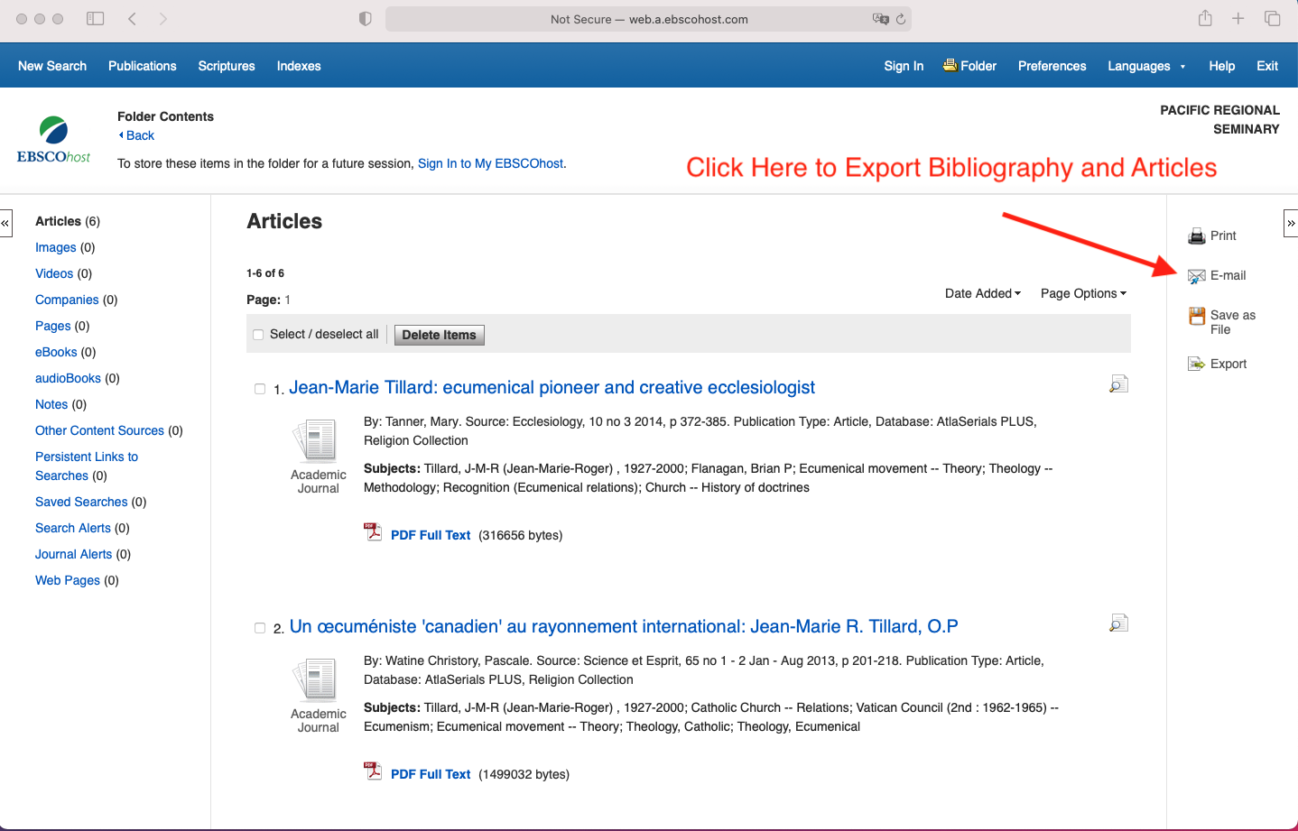
To Export Bibliography and Selected Articles

Slide 19
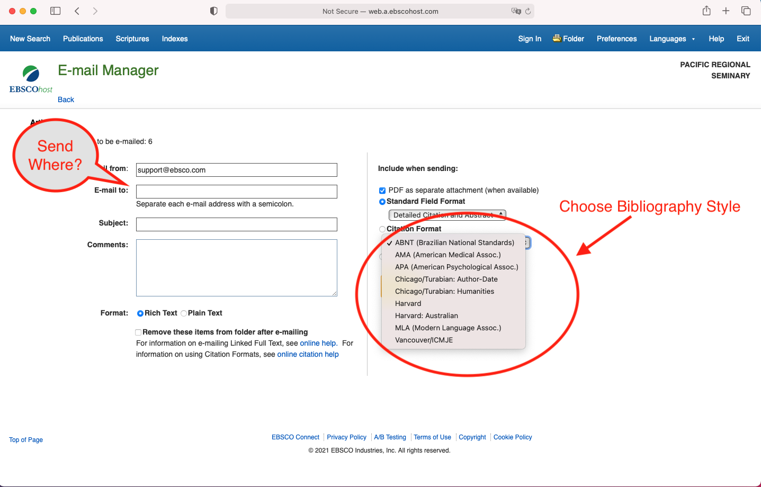
Fill in the information on the form

Slide 20
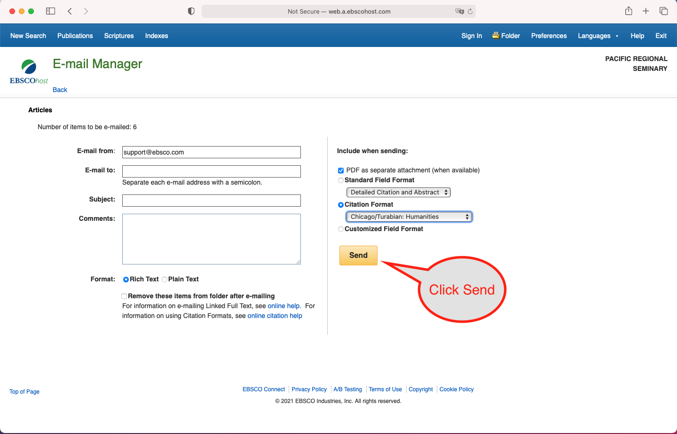
Send the data to your email

Slide 21
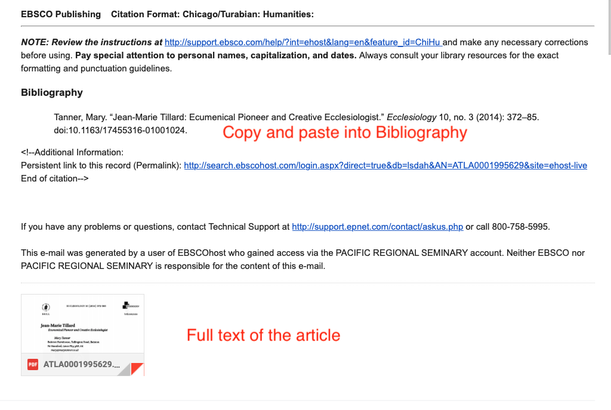
Information in Email

Slide 22
Click on PDF Full Text to access the article
Notes:
Click on the PDF Full Text link to access the work

Slide 23
Preview the article and download
Notes:
You can then preview and download the article

Slide 24
Download to your computer as a PDF
Notes:
Download the article as a PDF

Slide 25
Click on the Scripture link
2. Specific Scripture Texts
Notes:
You can also search for works on particular texts in the Bible. You can find works on individual books, chapters, and verses.

Slide 26
A list of all the books in the Bible will appear.
Notes:
See all the books

Slide 27
Click on [Expand] in any book to see each chapter
Notes:
Click on a book to see the chapters

Slide 28
Click on [Expand] again to see every verse in that chapter
Notes:
Chapter to see the verses

Slide 29
Click on a verse to see works relating to that verse

Slide 30
Other Types of Searches
Books
Essays or book chapters
Book reviews

